Slide 1
Course Wrap-up & Exam
Praveen Kumar
Computer Science and Engineering
Ohio State University

Slide 2
Agenda
Recap & Key Takeaways
Final Exam
Course objectives
Contacts
Labs Overview
Next Steps
Notes:
The agenda for today is:
Course objectives

Slide 3
Course Objectives
Fundamentals of distributed computing
Computational challenges in an Enterprise
Principles & Techniques used in addressing enterprise computing challenges
Application of distributed computing (Java EE):
Multi-tiered web application
Object Relational Mapping
APIs and Microservices
Messaging based integration
Amazon Web Services (AWS) foundations

Slide 4
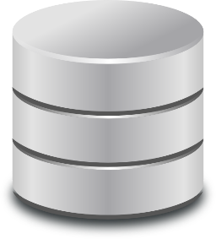
Labs Overview (Default Tech Stack)
Client Tier
HTML 5
CSS
JavaScript
AJAX
Presentation Tier
Servlet
JSP
Spring MVC
Batch Application
Business Tier
RESTful API (JEE)
Integration Tier
JMS
Web Service
(JAX-RS)
JPA (ORM)
H2

Slide 5
Alternative Tech Stack 1
Client Tier
HTML 5
Bootstrap
Angular
Presentation & Business Tier
Batch Application
RESTful API (JEE)
Integration Tier
JMS
Web Services
(JAX-RS)
JPA (ORM)
H2

Slide 6
Alternative Tech Stack 2
Client Tier
HTML 5
Bootstrap
Angular
Presentation & Business Tier
AWS
RESTful API (JEE)
API
(Micro Services)
API
(Micro Services)
API
(Micro Services)
Integration Tier
JMS
JPA
RDS
H2
Batch Application

Slide 7
Alternative Tech Stack 3
Client Tier
HTML 5
Bootstrap
Angular
AWS
API
(Micro Services)
AWS Lambda
AWS EventBridge
API
(Micro Services)
API
(Micro Services)
Batch
RDS
Aurora

Slide 8
Key takeaways

Slide 9
What is distributed computing?
Computation performed by a network of autonomous computers that communicate with each other in order to achieve a goal
Computers participating in a distributed computation are independent
They communicate with each other using messages
A single purpose behind the sequence of computations
Notes:
What is distributed computing?
First, let’s understand the word distributed. What does it mean? It means “spread out across space”.
Now, let's define the term “Distributed computing”. It is:
“computation performed by a network of autonomous computers that communicate with each other in order to achieve a goal”
There are a few key characteristics of distributed computing that you should pay attention to:
The first is autonomous, which means that the computers participating in a distributed computing are independent – they do not share memory or processors.
The second is that they communicate with each other using messages. Messages are pieces of information transferred from one computer to another over a network. These messages help to sequence or link the work done by different computers.
The third is that there is single purpose or end goal behind these sequence of spatially spread out computations.
Computers in a distributed system can have different roles & responsibilities. A computer’s role depends upon the end goal of the sequence of computations.

Slide 10
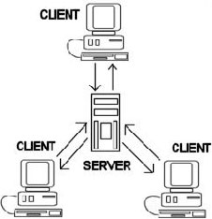

How does the distributed system work?
Client Server Architecture
Peer-to-Peer Architecture
Multiple clients consume a common service provided by the server for various purposes
Division of labor
Scales well, complex
environment
system
“computational tapestry”
Notes:
Now, that you understand what distributed computing is, let’s look at how the distributed systems work.
There are two predominant ways computers can be organized in a distributed system.
The first is client-server architecture. In this system, there is a single server that provides a common service, which is consumed by multiple clients for various purposes. The role of the server is to respond to service requests from clients, while clients’ job is to use the data provided in response, in order to perform a task. This model works very well in service-oriented solutions. However, the drawbacks are: (a) server becomes a single point of failure, and (b) resources become scarce if there are too many clients.
The second way to organize computers is in a peer-to-peer architecture. In this system, there is division of labor among participating computers (called “nodes”). It scales well, because various computers contribute processing power and memory, can switch roles, and new computers (nodes) can be added if needed. However, it also means high complexity because in order to ensure messages reach intended destinations, peer-to-peer systems must have an organized structure and each node must maintain enough information about its immediate neighbors. Failure pattern of these systems are also complex, and special techniques such as application health monitoring and business availability centers are utilized to make sure that the network is functional.

Slide 11
Growth of functional IT systems
Business Functions
Marketing
Accounting
Finance
Sales & Service
Human Resources
Marketing
Systems
Accounting
Systems
Finance
Systems
Sales & Service Systems
Human Resources Systems
Information Systems
Notes:
Let’s understand role of Information technology (IT) in an Enterprise.
The primary role of IT is to automate information intensive aspects of business functions.
It is very interesting how IT systems grow in an Enterprise.
Typically, an IT system is created and maintained within a department that own a particular business function.
For example, marketing department owns marketing activities of the company, such as market research & planning, campaigns and promotions, branding, marketing communications, media interactions, digital messaging and the like. They own the IT systems that automate these activities.
Thus IT systems grow in functional areas of an Enterprise. Functional IT systems contain business logic and data, forming the core of the intellectual capital of an Enterprise.
Now, the question arises: why these IT systems need distributed computing? Let’s discuss that next.

Slide 12
Why enterprises need distributed computing?
The value generating business processes in an Enterprise cut across functional areas
Functional areas need to interact!
Enterprises need distributed computing in order to implement these interactions among functional IT systems
Notes:
Why Enterprises need distributed computing?
One reason is that value generating business processes in an Enterprise cut across functional areas. This concept will become clearer to you in subsequent slides when I walk you through a couple of examples.
The point is that functional areas, specifically the IT applications within, need to interact, in order to implement cross functional business processes.
Enterprises need distributed computing in order to implement such interactions across functional IT systems.
Now, let's take a look at few examples that illustrate cross functional business processes.

Slide 13
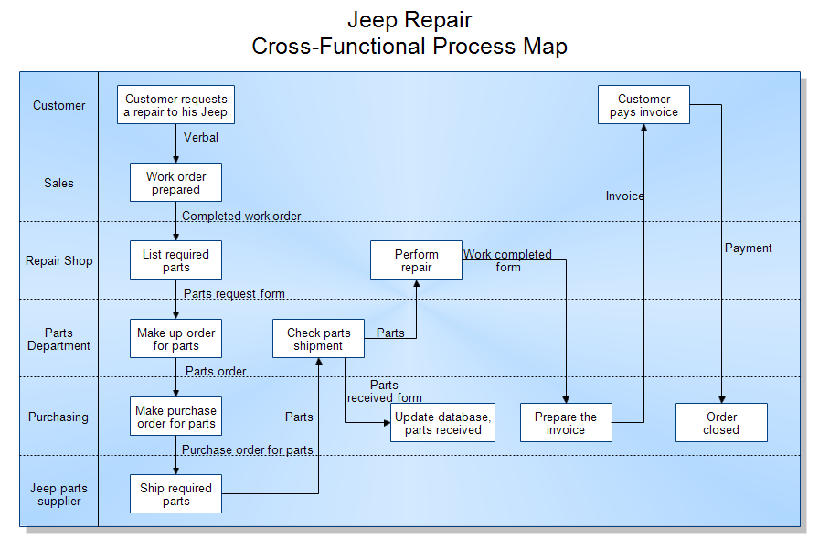
Cross functional process examples
Notes:
Here is another example of cross functional business process.
This process is semi-automated, in the sense that some of the activities as well as interactions are manual. The activities in the functional areas are represented by boxes, while the messages being passed between IT systems are represented by arrows. The content of the message is indicated by labels on the arrows.
The process begins with customer requesting repair to his Jeep. This request is verbal, and a person from sales department prepares the work order on his iPad and hits submit. A message containing completed work order is forwarded from the iPad to a computer in the repair shop, which in turn sends a message with requested parts list to a computer in the parts department. These interactions go on, until the order is closed by the purchasing department.
The interaction among various computers in this example, and the previous example meet all the three characteristics of distributed computing we discussed earlier:
Computers are independent
They communicate with each other using messages, and
There is a single goal which is responsible for the sequence of interactions

Slide 14
Enterprise Computing Environment
Actual application architecture for consumer electronics company (IBM)
Notes:
Here is an actual application architecture for a consumer electronics company, prepared by IBM. The complex, many-to-many relationships between strategies, business functions, IT applications, and data stores; should give anyone an idea that enterprise computing environment is very complex indeed.
The question arises, how do we understand this complexity? And, in particular, what can we do about it?
In order to answer these questions, let's explore the enterprise computing challenges a bit more in depth. First, let’s learn about Enterprise domains.

Slide 15
Enterprise Domains
An enterprise domain is high level view of certain aspect of the enterprise. It provides insights into how enterprise works.
Business domain – business goals, capabilities, business functions, processes, products, channels, roles etc.
Application domain – structure, behavior, and inter-relationship among applications used to support business
Data domain – data (storage and in motion) used by business functions and applications
Technology domain – infrastructure ( h/w, s/w, and network) and operations to support applications & data
Business Domain
Application Domain
Data
Domain
Technology Domain
Notes:
What is an enterprise domain?
An enterprise domain is high level view of a certain aspect of the enterprise. It provides insights into how enterprise works.
Business domain is about the business goals, capabilities, business functions, processes, products, channels, roles etc.
Application domain is about the structure, behavior, and inter-relationship among applications used to support business operations or activities.
Data domain is about the data (storage and in motion) used by business functions and applications.
Technology domain is about the infrastructure (i.e. hardware, software, and the network), as well as the operations to support applications and the data.
To get a holistic understanding of computing in an enterprise, let’s take a look at key challenges within one enterprise domain at a time.

Slide 16
How to approach?
Principle
Techniques
Patterns

Slide 17
Principle – Coupling & Cohesion (contd.)
A
A
B
B
C
C
high coupling
low coupling
Notes:
Here is an example of three software components A, B, and C interacting together in order to implement a business system.
In the diagram here, you can see tiny boxes inside each component. They represent a function or a method.
In order to do its job, a function may call other functions in another component, shown by lines.
On the left is an example of high coupling. The components interact with each other a lot, making them highly interdependent on each other. If you ever wanted to change component A, you will have no choice but to change components B, and C both, almost every time. That is high coupling. It is sometimes also called tight coupling.
On the right is an example of low coupling. The functions inside the components A, B, and C have been re-factored to reduce cross-component interdependence.
<pause>
The system on the right is less complex and will be easier to maintain and evolve.

Slide 18
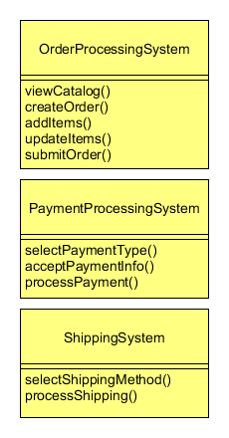
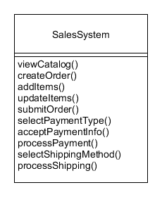
Principle – Coupling & Cohesion (contd.)
Low cohesion
High Cohesion
Notes:
Continuing our discussion, lets now understand what is cohesion.
Here is an example of an e-commerce application.
On the left side is a sales operations system, which consists of 10 methods, or let’s say 10 externally visible behaviors; is part of a single class called “SalesSystem”.
If you look closely, the methods in this class are not really related to each other, and do not belong together. For example, viewing the catalog of available products, creating and submitting order etc., are unrelated to selecting shipping method and processing the shipping.
This class is an example of low cohesion between its components.
It is complex, and maintaining it will be difficult.
On the right side, the same application is broken into 3 classes – OrderProcessingSystem, PaymentProcessingSystem, and ShippingSystem.
If you look at the methods closely, you will notice that these classes together have the same behavior as the SalesSystem on the left, however the methods inside each class, are closely related to each other and they belong together. These three new classes are examples of high cohesion.
It will be a lot easier to evolve and maintain the system on the right hand side.

Slide 19
Techniques in Enterprise Computing
Solution Architecture Design
Patterns
COTS
Notes:
There are three essential techniques that we will discuss today:
Solution Architecture Design
Use of Patterns, and
Commercial Off the Shelf software (called COTS)

Slide 20
Technology Categories
Enterprise Computing
Web & Mobile
Desktop Applications
Mainframe & Batch
Middleware
Data, Reporting, & Business Intelligence
Infrastructure & Operations
Notes:
Here is an overview of various categories of technologies used in a typical enterprise.
Web and Mobile technologies allow customers to interact with the enterprise, knows as B2C interaction.
Desktop technologies are typically used within the enterprise to automate internal operations.
Mainframe and Batch technologies are used for high volume information processing
Middleware technologies are used for integrating various applications, and enable cross-functional system interaction.
Data Management, Reporting, and Business Intelligence technologies enable various functional and cross-functional needs such as sales, service, and marketing.
Infrastructure & Operations technologies are critical to running the business operations
We will take a deeper dive into these technology categories next

Slide 21

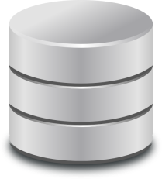

Architecture Choices – 2 Tier vs. 3 Tier
Rich/Fat Client
Presentation + Business Logic
Data
Thin Client
Presentation
Business Logic
Data
Notes:
Before we take a deep dive into an application’s architecture, Let’s first take a look at a very basic architecture choice that enterprises need to make. This choice will have a significant impact on how applications are architected internally.
Shown here are two architecture choices, 2-tier and 3-tier. In the 2-tier architecture, presentation and business logic are combined into one application, known as rich client, or fat client application. In the 3-tier application, presentation logic and business logic are divided up into two separate applications, and deployed on separate computers.
The 2-tier architecture is simple, and works well for small number of power users, within the enterprise’s core network. If designed properly, it can provide very high performance and will have a very simple run-time footprint to support and maintain. In order to improve performance, and/or support a growing number of users, you need to upscale the hardware on which data resides.
The 3-tier architecture is more complex. It is well suited for applications that need to be accessed by a very large number of users, that are outside of enterprise’s core network. Typically, a ubiquitous presentation application such as web browser is used, so that you can avoid installing the presentation application on each and every user’s computer. The business logic application can be deployed in a cluster of servers (also known as horizontal scaling) in order to improve performance and support a growing number of users.

Slide 22
Anatomy of an Application – Logical Tiers
Client Application
(Browser, Desktop Application, Flash)
Presentation Tier
Business Logic Tier
Integration Tier
(ORM, WS Client, Resource adapters)
Enterprise Resource
(Relational DB, External WS, Legacy Systems)
System Component Tier
(Authorization, Logging, Cache Mgmt, Transaction Mgmt, Connection Pool Mgmt, etc.)
Server
Notes:
Now, that you have understood the basics of a 3-tier application, let’s look deeper into an application.
An application is really composed of logical components called tiers. Each tier has a special role and responsibility.
For example, the role of the presentation tier is to interact with the user: present information, collect information input by them, and allow them to take action and submit requests.
The role of business logic tier is to decide what is an appropriate response of a certain user action.
The role of integration tier is to allow the application to interact with enterprise resources such as databases, external web services, and legacy applications (e.g. mainframe)
The role of system component tier is to address cross cutting needs such as authentication and authorization, logging, cache management, transaction management, connection pool management etc.
As application evolves, the tiers can evolve reasonably independent of each other.
The logical tiers are essentially an application of the separation of concerns principle. They follow a further refinement of the separation of concerns principle, known as “The Tier Principle”. Let’s learn about that next.

Slide 23
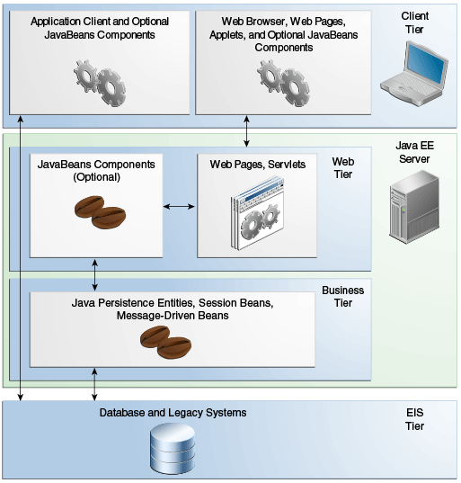
Java EE Overview (contd.)
Containers deployed on separate servers
Clustering supported
Popular Java EE Containers:
IBM Websphere, Oracle Weblogic Server, JBoss, Apache Tomcat, GlassFish , etc.
Notes:
Here is another diagram of the Java EE platform, which shows further details.
Containers are typically deployed on separate servers.
The web tier container, and the business tier containers can be deployed on the same server, or on separate servers.
If they are indeed separated, the computing gets divided, meaning distributed onto separate servers, and the components in the web tier are required to make remote calls to components in the business tier. They do that by using a Java EE protocol known as RMI over IIOP.
Clustering is supported by most modern JEE application servers, which enables horizontal scaling, load balancing, and fault tolerance. You learned about clustering in the previous lecture.
Some of the popular Java EE containers include IBM Websphere, Oracle Weblogic Server, JBoss, Apache Tomcat, and Oracle GlassFish.
Images: The Java EE Tutorial, <https://docs.oracle.com/javaee/7/tutorial/overview003.htm>

Slide 24
A dynamic Web App - using Servlets
Filesystem
html
Database
Internet
Web Server
html
html
Http Request
Default Handler
Servlet Engine
(Java EE Server)
Http Response
Servlet
Browser
Servlet
Plug-in
Servlet
Http Request: GET /reports/sales/index.html HTTP/1.0
Notes:
Let’s now look at what happens if the web server is configured to use a JEE Servlet engine on Java EE Server.
First of all, the web server needs to have a plug-in configured, known as Application Server plug-in. This configuration tells the web server, which request, based on URL pattern, should be forwarded to the Java EE Server for a dynamic response.
When a user request with matching URL is received, the web server forwards the request to servlet engine, which in turn calls an appropriate servlet object, based on a URL pattern based configuration.
The servlet object, which is the code written by application developer (say you), is responsible for accessing dynamic data, performing business logic, and returning a HttpServletResponse object. The servlet engine then constructs Http Response and returns.
Servlet engine, or servlet container, manages the servlet instances. We will learn about the servlet container and servlet API next.

Slide 25
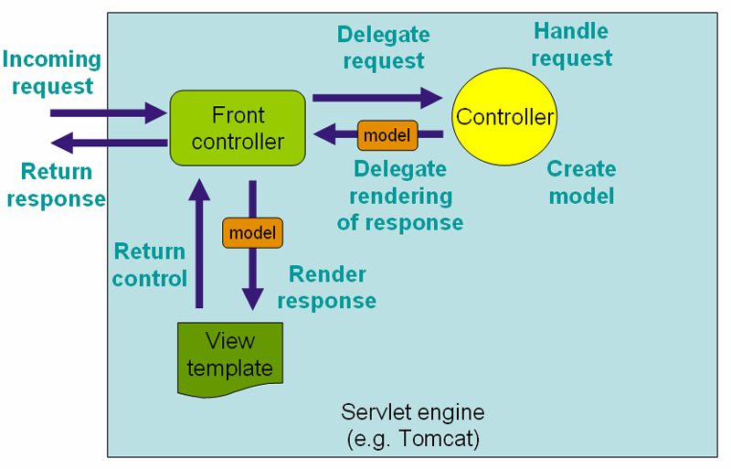
Request Processing Workflow
Source: http://docs.spring.io/spring/docs/4.2.0.RELEASE/spring-framework-reference/html/mvc.html
Notes:
Let’s take a look at how Spring MVC works. The diagram here describes the request processing workflow.
The incoming request is handled by a front controller servlet. The front controller then uses the handler mapping to determine appropriate controller object and delegates the request to it. The controller then handles the request by taking appropriate action, such as reading a database, or calling a business object, etc. The controller creates model object(s), and returns back to the front controller, delegating the rendering of response.
The front controller then uses view resolvers to determine the appropriate view (for example a JSP), which in turn prepares the complete view, and return the control back to the front controller. The front controller then returns the control to the servlet engine.
Picture Source: http://docs.spring.io/spring/docs/4.2.0.RELEASE/spring-framework-reference/html/mvc.html

Slide 26



Web UI Tier Overview
Web Pages consist of three things:
Content
paragraphs, lists, images, videos, hyperlinks, forms, table, etc.
Presentation
color, font, positioning of content, margins, and other layout details
Behavior
manipulation of page data, error checking, special effects, etc.
Notes:
Web pages consist of essentially three things
(1) Content. This may include paragraphs, lists, images, videos, hyperlinks, forms, table, etc.
(2) Presentation. This includes color, font, positioning of the content, margins, and other layout details
(3) Behavior. This includes manipulation of page data, error checking, special effects such as hover text etc.
The content is created using Hypertext Markup Language or HTML. The presentation is handled using Cascading Stylesheet of CSS, and the dynamic behavior is implemented using JavaScript.
Today, you will learn about all these technologies so that you can construct user interface for a modern web application.

Slide 27
Monolith Applications
The entire business logic can be built as a singular, self-sufficient application called monolith
Traditional style, application contains lots of functionality and business logic
Complex, expensive to change and evolve
Risk of falling into big ball of mud anti-pattern
User Interface
Payment Business Logic
Order Processing Business Logic
Shipping Business Logic
Data Access
Database
An Example Monolith
Notes:
One way to build applications is to contain the entire business logic into a singular, self-sufficient application called monolith.
Here is an example monolith used for eCommerce. It has a user interface. It has a business tier which contains business logic to support three functions – customer order processing, handling payments, and handling shipping of items that the customer ordered online. It has a set of data access objects that business tier uses to interact with a database shown here. The business tier objects tend to be tightly coupled.
Such applications were built during early days of software development, and they are still commonplace in large enterprises. That’s is why you can call them the traditional style, where the monolith application contains lots of functionality with lots of business logic in one place.
In this example, the number of functionalities supported by the business tier in THREE. In real-life, that can be dozens. What will be the result?
A lot of objects in the business tier, right! How about complexity? And coupling among those objects? VERY HIGH, right?
The monoliths are complex, and they are expensive to change and evolve.
There is an inherent risk of falling into big ball of mud anti-pattern, meaning that code will likely proceed towards spaghetti-code jungle.

Slide 28
Microservices
An architecture style to build applications using small, loosely-coupled services
Connectivity via a well-defined interface called API
Typically organized by business capability, referred to as bounded context
Independent tech stack, data storage & deployment
User Interface
API
API
API
Payment Business Logic
Order Processing Business Logic
Shipping Business Logic
Data Access
Data Access
Data Access
Database
Database
Database
A Microservice
An Example of Microservices Architecture
Coupled Microservices ➔ Distributed Monolith!!

Slide 29

API
API stands for Application Programming Interface
It is a combination of protocol and methods that define how an application’s functionality and data can be accessed
In today’s hyperconnected world, APIs play a key role. However, the protocol & methods need to be standardized to enable ubiquitous connectivity

Slide 30
Web API (a.k.a. REST API)
A standard way to specify API for an application (monolith or microservices)
The 3 standards are:
Protocol | HTTP
Methods | GET, POST, PUT, DELETE, HEAD, CONNECT, OPTIONS, TRACE
Format of input/output data | JSON (JavaScript Object Notation)
REST – Representative State Transfer; an architectural style using HTTP

Slide 31
API Gateway
API Gateway
Monolith 1
API
Web Application
API
API
Mobile Application
API
Microservice 1
3rd party Application
Microservice 2
API
Single entry point for all APIs available in the enterprise (implemented by monoliths or microservices)
Client applications do not know or care about implementation
Value Add – security, call routing, location transparency

Slide 32
API-First Approach
It is a philosophy used in Enterprises
API design comes before any implementation
Team builds robust API before any UI
API is application’s first interface!
Benefits of API-First in a large enterprise
Parallel software development
Accelerated development / reduced risk of failure
Optimized development costs
Improved developer/team satisfaction

Slide 33

… do you have an API for that?
That is a conversation business partners have routinely these days!

Slide 34
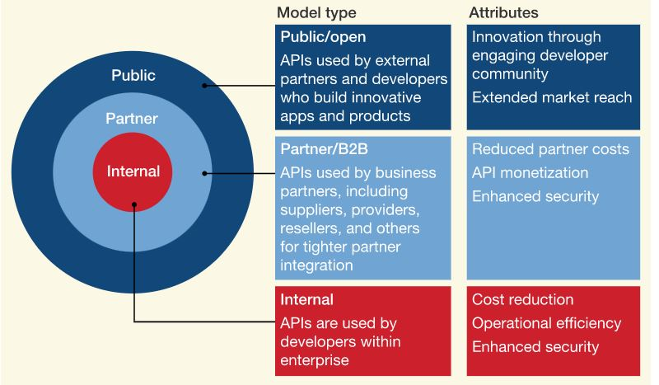
API Models
Source: https://www.mckinsey.com/industries/financial-services/our-insights/data-sharing-and-open-banking

Slide 35
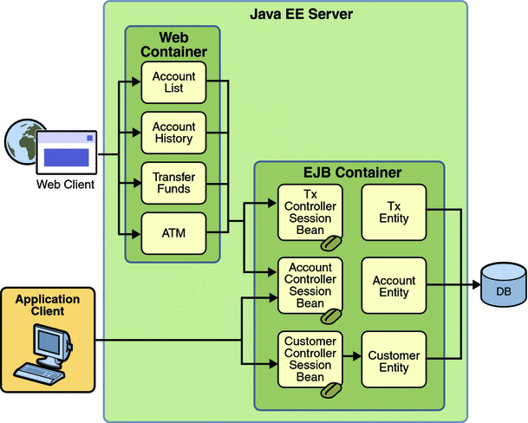
Java Persistence API (JPA)
JEE component for object relational Mapping (ORM)
Run in Web or EJB container
Container handles connection pool, transaction, concurrency, isolation levels, security, etc.
Image Credit: Duke’s Bank example: https://docs.oracle.com/javaee/5/tutorial/doc/bnbyl.html

Slide 36
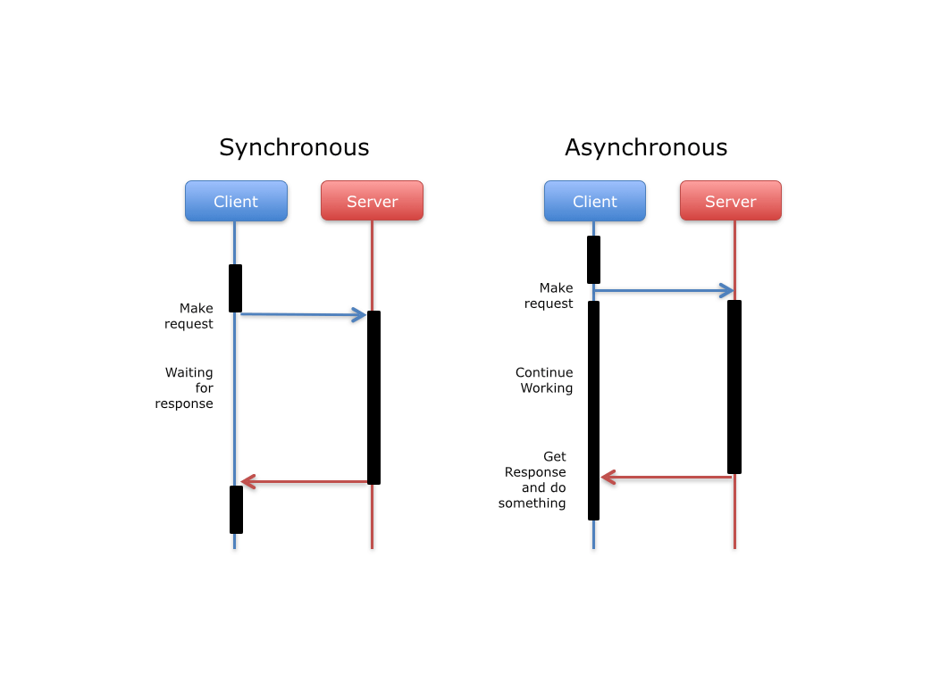
What is Asynchronous?

Slide 37
Synchronous vs. Asynchronous
Synchronous
Asynchronous
The client’s thread blocks (i.e., waits for response) and can’t do anything meaningful. This is a waste of resources
Server must be up and running when client makes the call
Request – Response
Caller’s thread does not block, making best use of underlying resources
Server pulls the message whenever it is free, and does not have to be up and running when client makes the call
Fire-and-Forget

Slide 38
When to choose Asynchronous?
Business process is inherently asynchronous – it must inform other processes but continue to operate without waiting for response
An application needs to operate regardless of whether dependencies are up and running
Service provider needs complete decoupling from clients – components might need to be completely replaced and/or relocated
Notes:
When should you choose messaging over other integration mechanism?
Here are a few cases, when messaging will be the right choice.
If the business process is inherently asynchronous, that is, it must inform other processes about something, but continue to operate without waiting for any response
When an application is required to operate whether or not dependencies are up and running. You might have such a scenario when dependent applications are owned and operated by organizations that you have no control over, and
When a service provider needs complete decoupling from clients – the components on the provider application may need to be completely replaced, and/or relocated without affecting any of the clients.
When you notice some or all of the these conditions apply to the problem domain, you should consider message based integration.

Slide 39
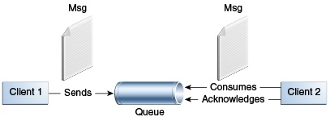
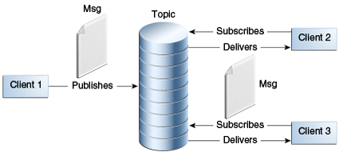
Messaging Styles
(1) Point-to-Point
(2) Publish/Subscribe
Notes:
There are two fundamentally different ways applications can send messages to each other.
The first is point to point style of messaging. This is based on the concept of message queues. Each message is addressed to a specific queue, and meant for one receiver. The receiving client extracts the message and acknowledges it. Queues retail all messages until the messages are consumed or expire.
The second is publish/subscribe style is messaging. Clients address messages to a topic, which functions like a bulletin board. Publishers and subscribers an dynamically publish or subscribe to the topic. The system takes care of distributing the messages arriving from a topic's multiple publishers to its multiple subscribers. Topics retain messages only as long as it takes to distribute them to subscribers.
The publish/subscribe or pub/sub style has two characteristics:
Each message can have multiple consumers
A client that subscribes to a topic, can consume messages that arrive after it has created a subscription.
Now that you have a good understanding of messaging core concepts, let’s learn how to use Java Messaging Service provided by JEE framework.

Slide 40
Reactive Systems
Reactive systems is an architecture in which independent systems integrate with each other using asynchronous messaging
Systems built this way are robust, resilient, flexible, and better positioned to meet modern demands
A set of standards and mindset are needed

Slide 41
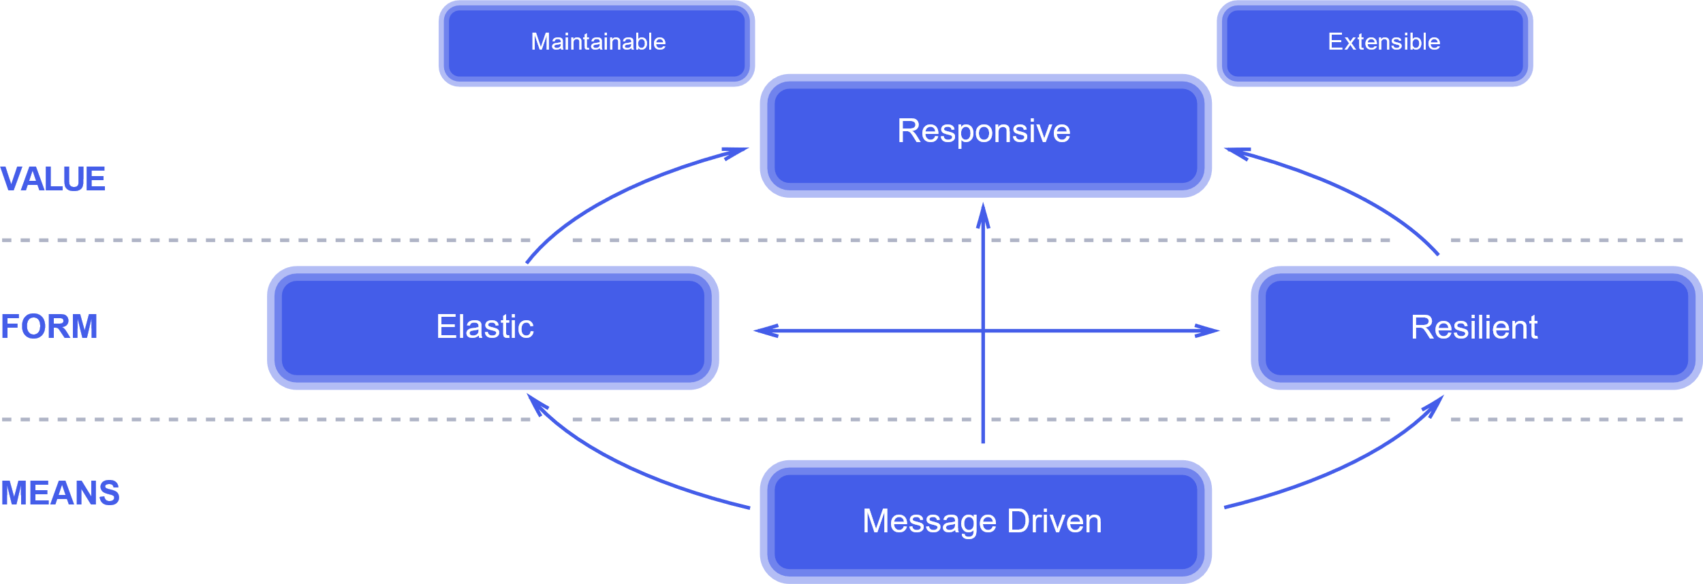
Traits of Reactive Systems
Traits of Reactive Systems,
Source: https://www.reactivemanifesto.org/

Slide 42
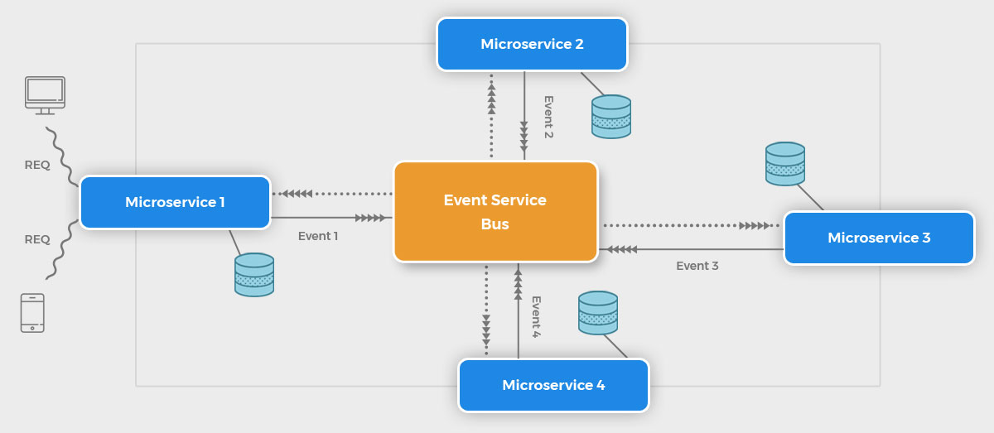
Reactive Microservices
Notes:
Event Brokers or Event Service Bus have given rise to another architecture style – called reactive microservices architecture. This is still evolving, but it is definitely the future.

Slide 43
Reactive Microservices
A microservices based architecture that uses the reactive streams as integration backbone
Provides design principles and best practices

Slide 44
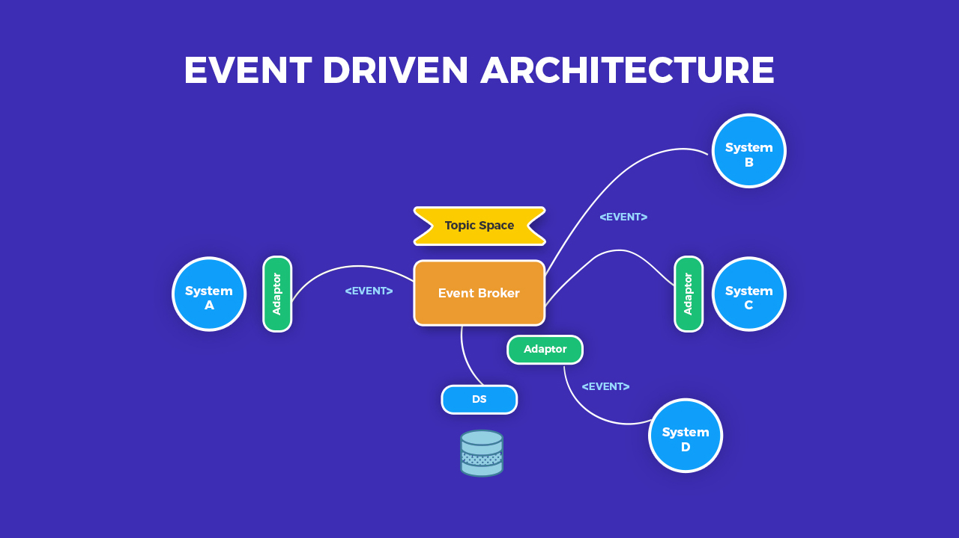
Event Broker / Event Service Bus
Image Credit: https://softobiz.com/understanding-the-event-driven-architecture/

Slide 45
API Security – Best Practices
Vulnerabilities (detection & correction)
Security Tokens
Encryption
OAuth & OpenID Connect
Throttling & Quotas
Authentication on API Gateway
Zero-Trust Approach

Slide 46
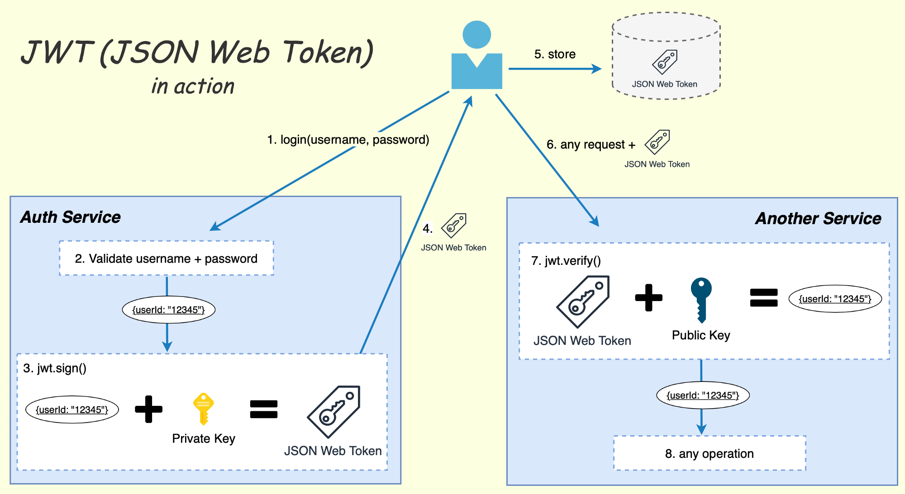
How does JWT work – contd.
Source: https://losikov.medium.com/part-6-authentication-with-jwt-json-web-token-ec78459b9c88
Notes:
An Enterprise typically uses API Gateway to implement Auth Service. All the APIs configured on this API Gateway honor the JWT issued by the gateway.

Slide 47
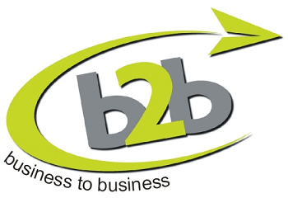

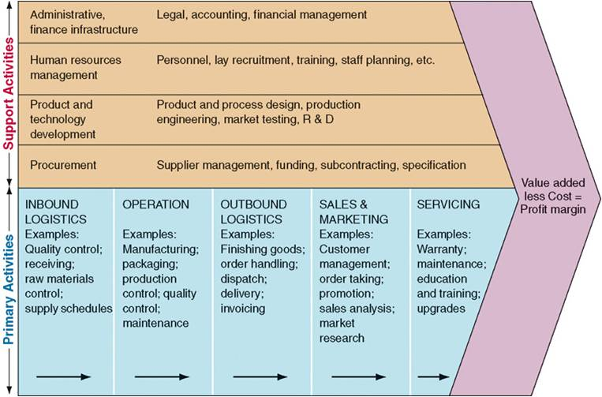


Extended Enterprise or B2B
Network of independent firms with specialized expertise, that collaborate to create an efficient value chain
Notes:
First, let’s understand what is an extended enterprise.
It is a network of independent firms with specialized expertise, that collaborate to create an efficient value chain.
Here is a diagram from the first lecture, which shows that value chains of Proctor & Gamble, Amazon, and UPS are inter-linked. P&G products are sold by amazon, and then shipped to customers by UPS, thus creating a value chain across enterprises.
Extended enterprise is also known as Business-to-Business or B2B.

Slide 48
Next Steps

Slide 49
What to learn next?
Bootstrap for building professional GUI
Single Page Application (SPA) frameworks
API Gateways & API Security
Reactive Systems & Reactive Microservices
Unit Testing (JUnit) & Test-Driven Development
Continuous Integration (Concourse/Jenkins)
AWS Serverless architecture and Lambda

Slide 50
Student Evaluation of Instructions (SEI)
Opportunity for you to provide feedback
I use it to fine-tune and improve the course
Provide honest feedback, even if everything went smoothly (i.e., reinforce positives)
It is open now, will close before the finals

Slide 51
Final Exam

Slide 52
Final Exam Format
One 2-hour long online session
Two sections
Multiple choice & short answers (20%)
Application of distributed computing (80%)
Section 1
Select one or more answers (similar to Quiz)
Short answer (2 – 3 key words)
Recall of key concepts from lectures

Slide 53
Final Exam Format
Section 2
One short narrative (describe an enterprise)
Multiple short questions (4 - 5)
Draw and show key components of application
Draw and label recommended integration technique
Recommend technology component
Scope limited to what you did in labs/quiz
Sample exam available in Module 12

Slide 54
Contacts
Ohio State University – Senior Lecturer kumar.388@osu.edu
Nationwide Insurance – Enterprise Architect praveen.kumar@nationwide.com
Personal – Architecture communities & forums p_kumar2@yahoo.com
LinkedIn, Twitter (Praveen Kumar)

Slide 55
APPENDIX

